Slide 1

Introduction to Razor
View Engine Essentials, Views & Layouts
SoftUni Team
Technical Trainers
Software University
http://softuni.bg

Slide 2
Table of Contents
View Engine Essentials
How Controllers determine Views
Razor Syntax
HTM Helpers, Tag Helpers etc…
Passing data to Views
ViewBag, ViewData, Strongly-Typed Views
Views & Layouts
Partials, View Components etc…

Slide 3
Have a Question?
sli.do #csharp-web

Slide 4

View Engine Essentials

Slide 5
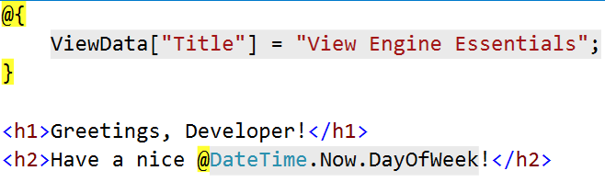
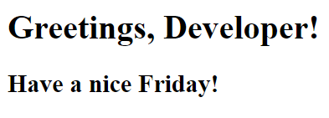
View Engine Essentials
Views in ASP.NET Core MVC use the Razor View Engine to embed .NET Code in HTML Markup.
Usually, they contain minimal logic, related only to presenting data
Data can be passed to a View by using the ViewData, ViewBag or through a ViewModel (Strongly-Typed View).

Slide 6

Passing Data to a View
With ViewBag (dynamic type):
Action: ViewBag.Message = "Hello World!";
View: @ViewBag.Message
With ViewData (dictionary)
Action: ViewData["message"] = "Hello World!";
View: @ViewData["message"]
With Strongly-typed views:
Action: return View(model);
View: @model ModelDataType;

Slide 7
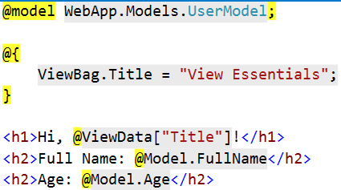
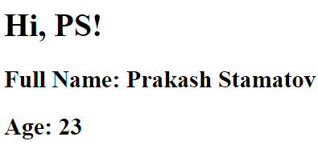
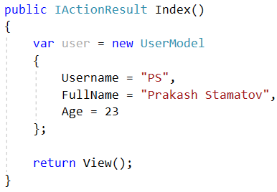
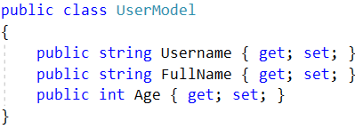
How it works?
Index.cshtml
HTML Output
Template
+
Data
=
Generated Output
UsersController.cs
UserModel.cs

Slide 8
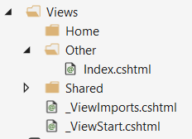
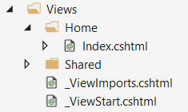
Returning Views
The Base Controller class provides a lot of functionality
View() method – One of the most frequently used Controller class members
public class HomeController : Controller {
public IActionResult Index()
{
return this.View();
}
}
public IActionResult Index()
{
return
this.View("~/Views/Other/Index.cshtml");
}

Slide 9
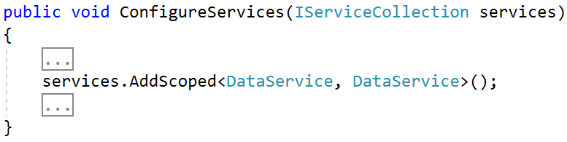
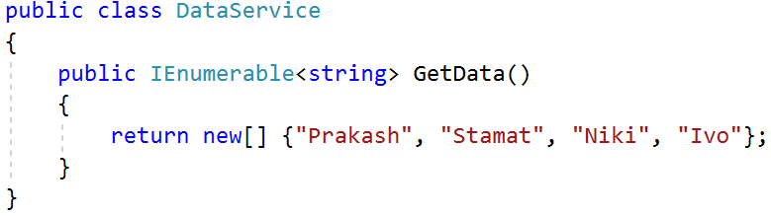
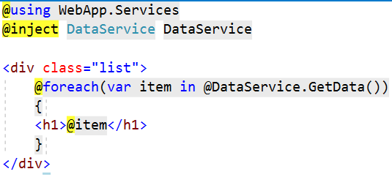
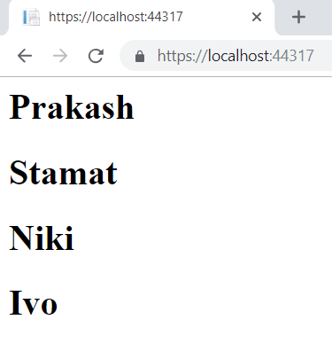
Views – Dependency Injection
ASP.NET Core supports dependency injection into views.
You can inject a Service into a View by using @inject

Slide 10

Razor Syntax

Slide 11
Razor Syntax
@ – For values (HTML encoded)
@{ … } – For code blocks (keep the view simple!)
<p>
Current time is: @DateTime.Now!!!
Not HTML encoded value: @Html.Raw(someVar)
</p>
@{
var productName = "Energy drink";
if (Model != null) { productName = Model.ProductName; }
else if (ViewBag.ProductName != null) { productName = ViewBag.ProductName; }
}
<p>Product "@productName" has been added in your shopping cart</p>

Slide 12
Razor Syntax (2)
If, else, for, foreach, etc. C# statements
HTML markup lines can be included at any part
@: – For plain text line to be rendered
<div class="products-list">
@if (Model.Products.Count() == 0) { <p>Sorry, no products found!</p> }
else
{
@:List of the products found:
foreach(var product in Model.Products)
{
<b>@product.Name, </b>
}
}
</div>

Slide 13
Razor Syntax (3)
Comments
What about "@" and emails?
@*
A Razor Comment
*@
@{
//A C# comment
/* A Multi
line C# comment
*/
}
<p>
This is the sign that separates email names from domains: @@<br />
And this is how smart Razor is: spam_me@gmail.com
</p>

Slide 14
Razor Syntax (4)
@(…) – Explicit code expression
@using – for including namespace into view
@model – for defining the model for the view
<p>
Current rating(0-10): @Model.Rating / 10.0 @* 6 / 10.0 *@
Current rating(0-1): @(Model.Rating / 10.0) @* 0.6 *@
spam_me@Model.Rating @* spam_me@Model.Rating *@
spam_me@(Model.Rating) @* spam_me6 *@
</p>
@using MyFirstMvcApplication.Models;
@model UserModel
<p>@Model.Username</p>

Slide 15
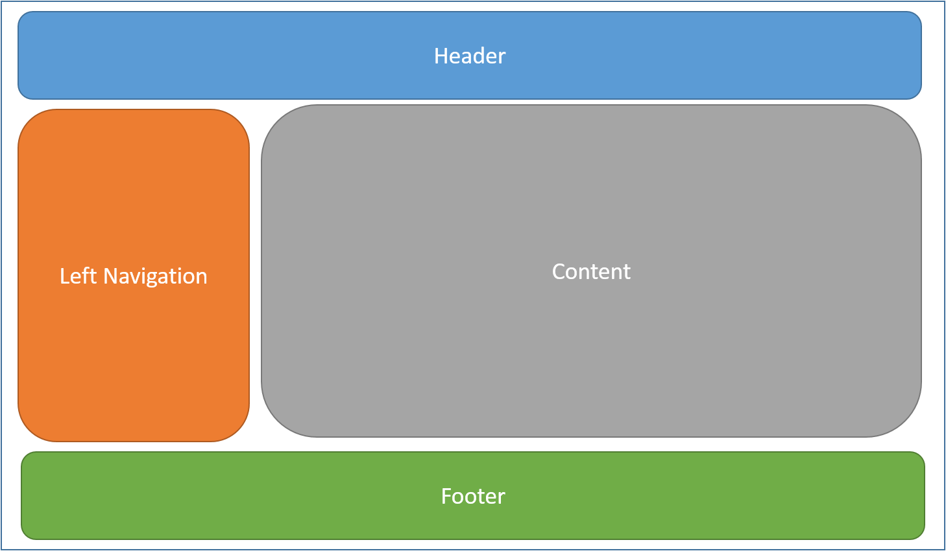
Views & Layouts

Slide 16
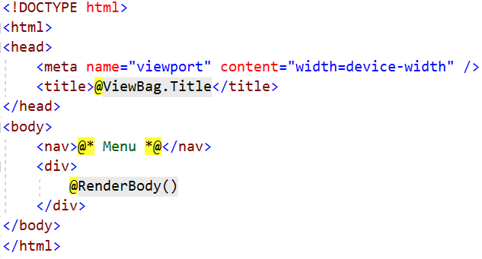
Layout
Define a common site template
Razor View engine renders content inside-out
First the View is rendered, and after that – the Layout
@RenderBody() – indicate where we want the views based on this layout to “fill in” their core content at that location in the HTML

Slide 17
Views and Layouts
Views don't need to specify layout since their default layout is set in their _ViewStart file:
~/Views/_ViewStart.cshtml (code for all views)
Each view can specify custom layout pages
Views without layout:
@{
Layout = "~/Views/Shared/_UncommonLayout.cshtml";
}
@{
Layout = null;
}

Slide 18
Views and Layouts
If a directive or a dependency is shared between many Views it can be specified globally in the ViewImports:
~/Views/_ViewImports.cshtml (code for all views)
This file does not support other Razor features
@using WebApplication1
@using WebApplication1.Models
@using WebApplication1.Models.AccountViewModels
@using WebApplication1.Models.ManageViewModels
@using Microsoft.AspNetCore.Identity
@addTagHelper *, Microsoft.AspNetCore.Mvc.TagHelpers

Slide 19
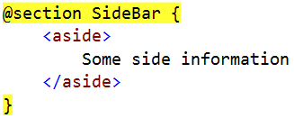
Sections
You can have one or more "sections" (optional)
They are defined in the views:
And may be rendered anywhere in the layout page using the method RenderSection()
@RenderSection(string name, bool required)
If the section is required and not defined, an exception will be thrown (IsSectionDefined())

Slide 20
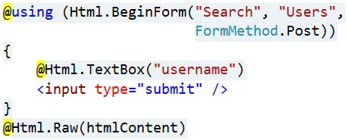
View Helpers
Each view inherits RazorPage
RazorPage has a property named Html
The Html Property has methods that return string can be used to:
Create inputs
Create links
Create forms
HTML Helpers
@Html.ActionLink | @Html.TextBox
@Html.BeginForm | @Html.TextArea
@Html.CheckBox | @Html.Password
@Html.Display | @Html.Hidden
@Html.Editor | @Html.Label
@Html.DropDownList | @Html.RadioButton

Slide 21


Tag Helpers
Tag Helpers enable the participation of Server-side code in the HTML element creation and rendering, in Razor views
There are built-in Tag Helpers for many common tasks
Forms, Links, Assets etc.
There are custom Tag Helpers in GitHub repos and NuGet
Tag Helpers provide
An HTML-friendly development experience
A rich IntelliSense environment for creating Razor markup
A more productive, reliable and maintainable code

Slide 22
Tag Helpers vs HTML Helpers
Tag Helpers attach to HTML elements in Razor Views
Tag Helpers reduce the explicit transitions between HTML & C#
Tag Helpers make the Razor markup quite clean and the views – quite simple
HTML Helpers are invoked as methods which generate content
HTML Helpers tend to include a lot of C# code in the markup
HTML Helpers use complex and very C#-specific Razor syntax in some cases

Slide 23
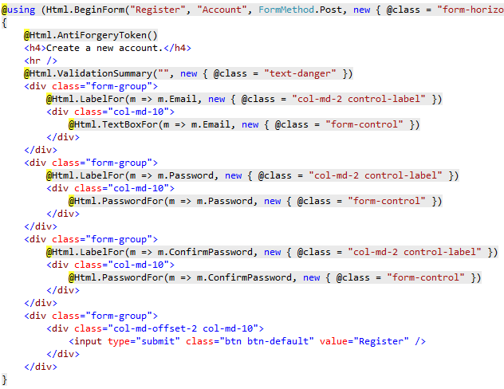
Tag Helpers vs HTML Helpers
This is an HTML Form purely designed with HTML Helpers
It is quite complex & heavy
It has a lot of C# (gray code)

Slide 24
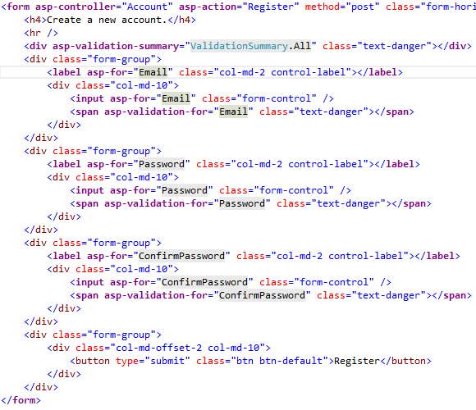

Tag Helpers vs HTML Helpers
This is the same form with an alternative approach with Tag Helpers

Slide 25
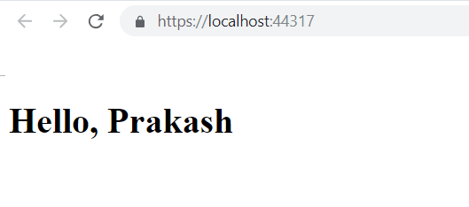
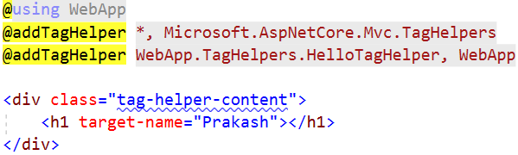
Creating your own Tag Helper
[HtmlTargetElement("h1")]
public class HelloTagHelper : TagHelper
{
private const string MessageFormat = "Hello, {0}";
public string TargetName { get; set; }
public override void Process(TagHelperContext context, TagHelperOutput output)
{
string formattedMessage = string.Format(MessageFormat, this.TargetName);
output.Content.SetContent(formattedMessage);
}
}
Index.cshtml

Slide 26

Shared Views & View Components

Slide 27
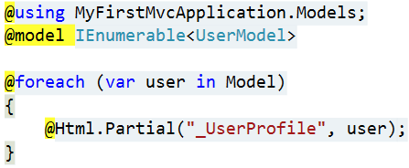
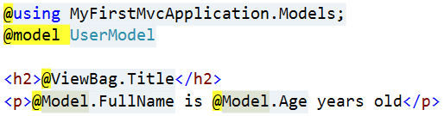
Partial Views
Partial Views render portions of a page
Reuse pieces of a view
Html helpers – Partial, RenderPartial and Action
Razor partial views are still .cshtml files
Sub-request
Located in the same folder as other views or in Shared folder

Slide 28


View Components
View Components are similar to Partial Views but much more powerful
No model binding
Depend only on the data provided to it
View Components:
Render a chunk rather than a whole response
Can have parameters and business logic
Is typically invoked from a Layout page
Includes the same S-o-C and testability benefits between controller / view

Slide 29
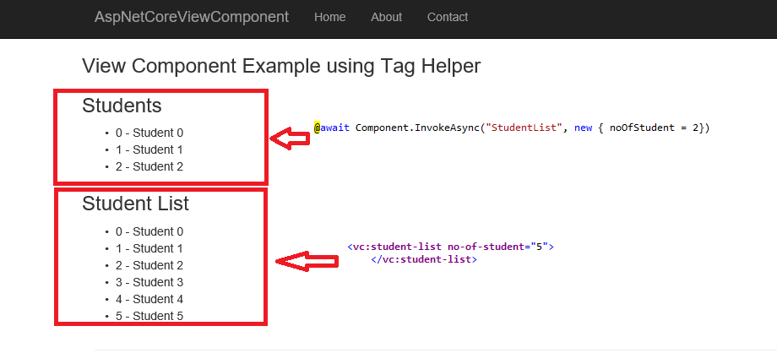
View Components
View components are intended anywhere you have reusable rendering logic that's too complex for a partial view
Dynamic navigation menus
Login panels
Shopping carts
Sidebar content
Recently published articles
Tag cloud

Slide 30
View Components
View Components consist of 2 parts:
A class – typically derived from ViewComponent
A result – typically a View
View Components
Define their logic in a method called InvokeAsync()
Never directly handle a Request
Typically initialize a Model which is passed to the View

Slide 31
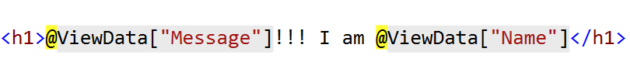
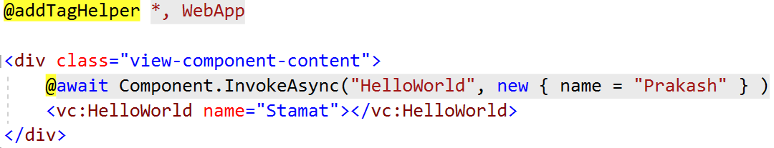
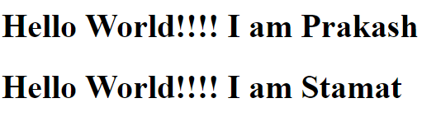
Defining your own ViewComponent
[ViewComponent(Name = "HelloWorld")]
public class HelloWorldViewComponent : ViewComponent
{
private readonly DataService dataService;
public HelloWorldViewComponent(DataService dataService)
{
this.dataService = dataService;
}
public async Task<IViewComponentResult> InvokeAsync(string name)
{
string helloMessage = await this.dataService.GetHelloAsync();
this.ViewData["Message"] = helloMessage;
this.ViewData["Name"] = name;
return View();
}
}
~Views/Shared/Components/HelloWorld/Default.cshtml
Index.cshtml

Slide 32

Shared Views & View Components
Live Demo

Slide 33

Summary
Razor View Engine Essentials
Razor Syntax
Tag Helpers & HTML Helpers
Views & Layouts
Shared Views & View Components
Dependency Injection
…
…
…

Slide 34
https://softuni.bg/trainings/courses

Slide 35













SoftUni Diamond Partners

Slide 36





SoftUni Organizational Partners

Slide 37




Trainings @ Software University (SoftUni)
Software University – High-Quality Education and Employment Opportunities
softuni.bg
Software University Foundation
http://softuni.foundation/
Software University @ Facebook
facebook.com/SoftwareUniversity
Software University Forums
forum.softuni.bg

Slide 38

License
This course (slides, examples, demos, videos, homework, etc.) is licensed under the "Creative Commons Attribution-NonCommercial-ShareAlike 4.0 International" license

